Slide 1
Bhopal Gas Disaster
Marina Grimmett

Slide 2
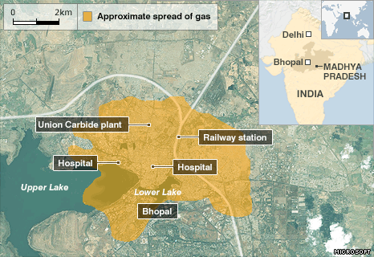
Bhopal, India
December 2nd, 1984

Slide 3
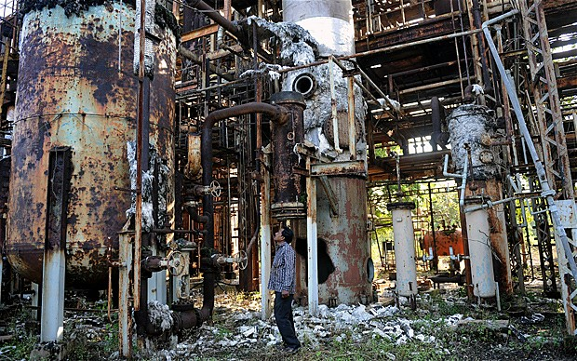
Union Carbide pesticide plant

Slide 4
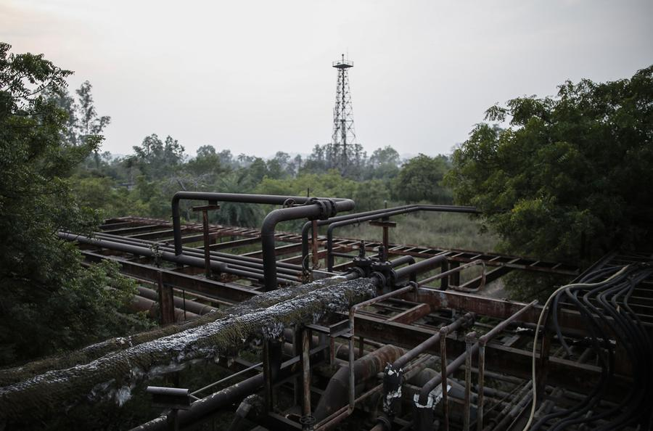
Cause of accident

Slide 5
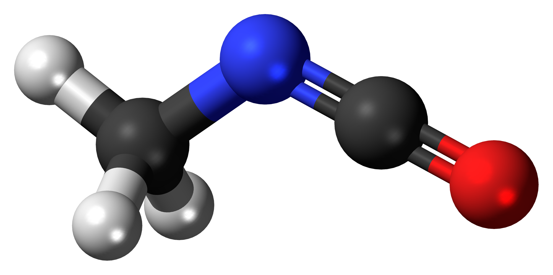
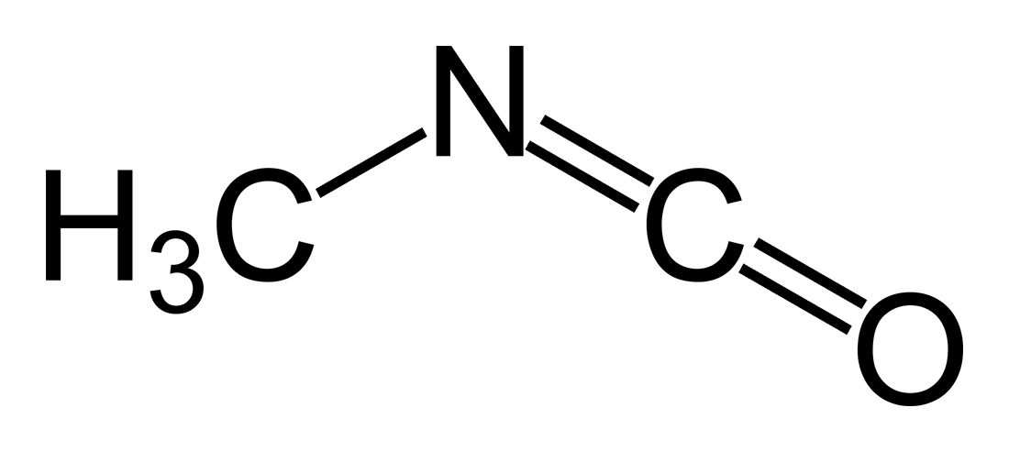
Methyl Isocyanate

Slide 6
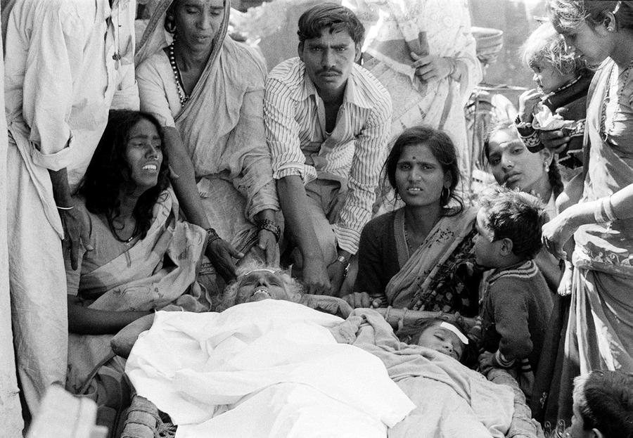
Harm caused

Slide 7
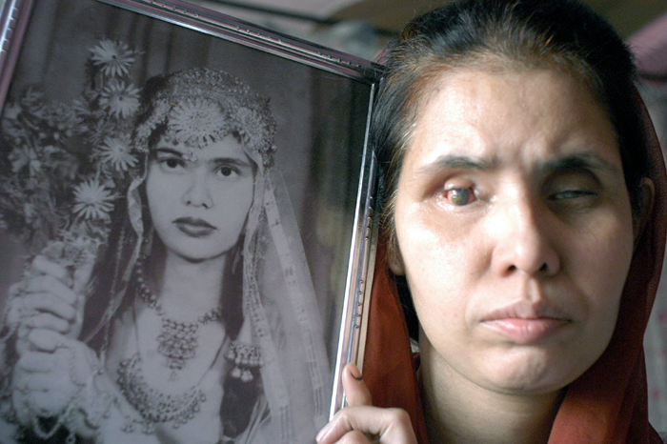
Direct Contact

Slide 8
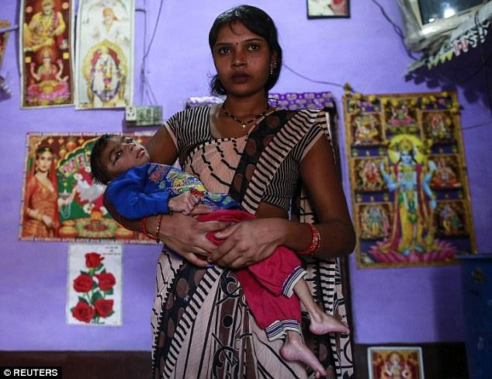
Birth Defects

Slide 9
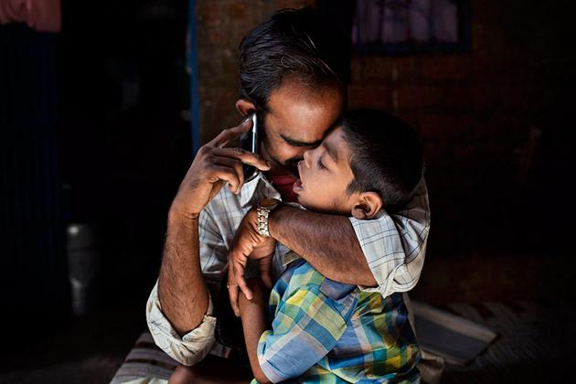
Other diseases

Slide 10
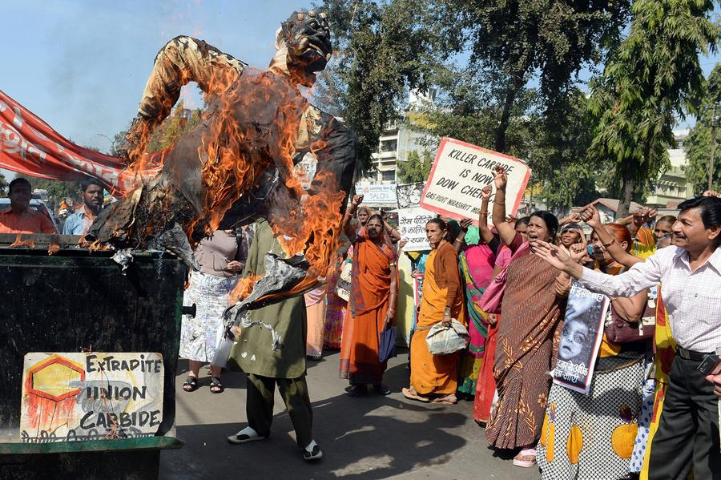
Legal action

Slide 11
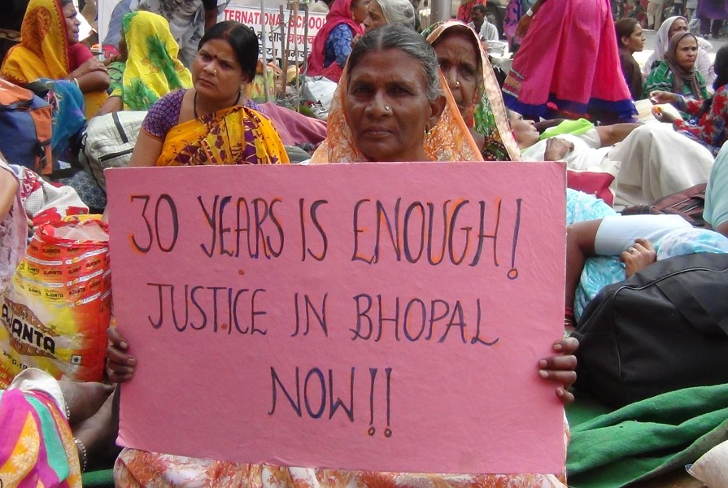
Current Status

Slide 12
http://www.theatlantic.com/photo/2014/12/bhopal-the-worlds-worst-industrial-disaster-30-years-later/100864/
http://www.ndtv.com/photos/news/bhopal-gas-tragedy-verdict-and-after-7520#photo-84309
http://www.motherjones.com/environment/2014/06/photos-bhopal-india-union-carbide-sanjay-verma-pesticides-explosion
http://www.spiegel.de/international/world/disaster-persists-30-years-after-bhopal-gas-catastrophe-a-1006101.html

